Slide 1
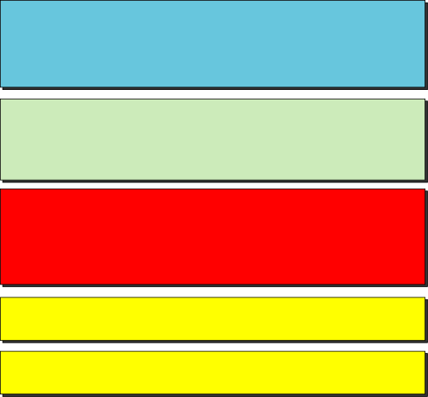
Chapter 13
Stream Control Transmission Protocol
Objectives
Upon completion you will be able to:
Be able to name and understand the services offered by SCTP
Understand SCTP’s flow and error control and congestion control
Be familiar with the fields in a SCTP segment
Understand the phases in an SCTP association
Understand the SCTP state transition diagram
Notes:
Chapter16 in 4th edition，如同前面的多播路由协议，随着流媒体通信等应用需求的增加，需要新的传输层协议，SCTP就是其中一类，一个新的传输层协议

Slide 2
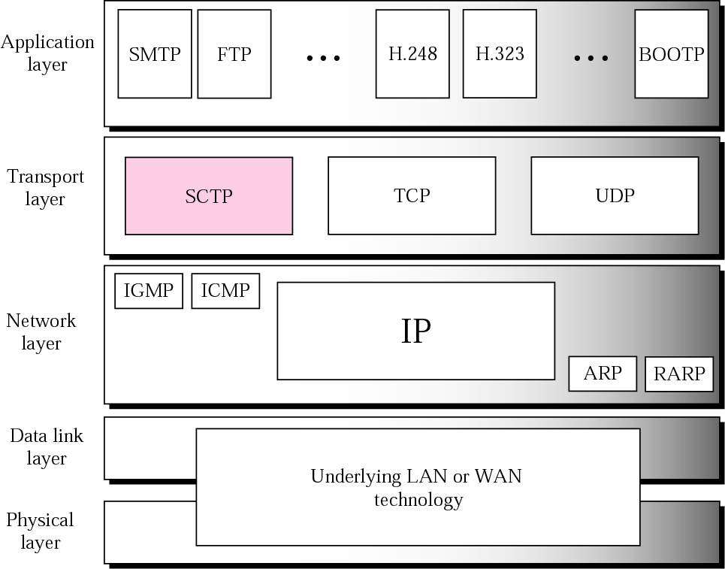
Figure 13.1 TCP/IP protocol suite
Notes:
H.248流媒体网关，H.323 IP电话，SIP 软交换电话等，既需要可靠通信，又需要UDP用户报文协议的一些服务；
UDP面向报文，保留报文边界，不可靠，缺乏流控制和差错控制，TCP面向字节流，可靠通信，不保留报文边界

Slide 3
Note:
SCTP is a message-oriented, reliable
protocol that combines the
good features of UDP and TCP.
Notes:
结合两者优点，保留报文边界，也检测丢失数据 重复数据及乱序数据，拥塞控制和流控制机制，以及一些新特性

Slide 4
13.1 SCTP SERVICES
We explain the services offered by SCTP to the application layer processes.
The topics discussed in this section include:
Process-to-Process Communication 进程到进程的通信
Multiple Streams 多重流
Multihoming 多归属
Full-Duplex Communication 全双工
Connection-Oriented Service 面向连接
Reliable Service 可靠的

Slide 5
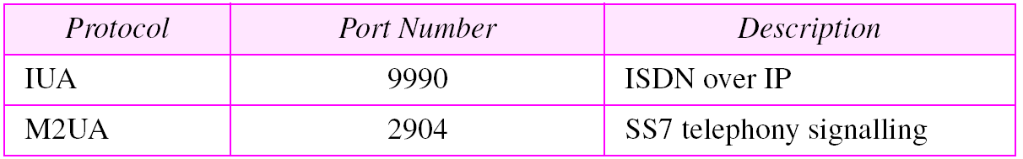
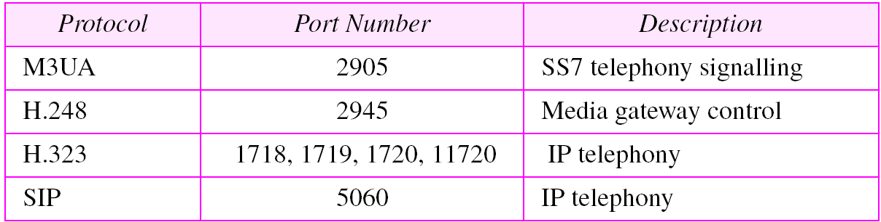
Table 13.1 Some SCTP applications
Notes:
进程到进程，Background：电信网，信令与用户数据相分离的原则。

Slide 6
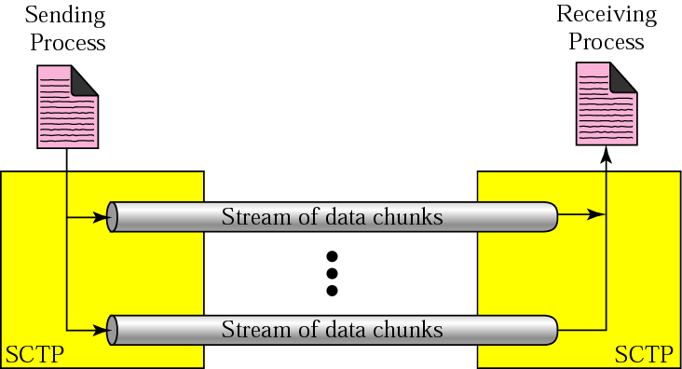
Figure 13.2 Multiple-stream concept
Notes:
多重流，考虑到TCP中的差错或丢包等异常中，重传会造成后续数据被阻塞，不适合音视频通信场景，所以在SCTP中允许多重流服务，关联association， 好处是当1个流被阻塞了，其它流还可以继续交付数据，类似多车道，公交快速通道

Slide 7
Note:
An association in SCTP can involve multiple streams.

Slide 8
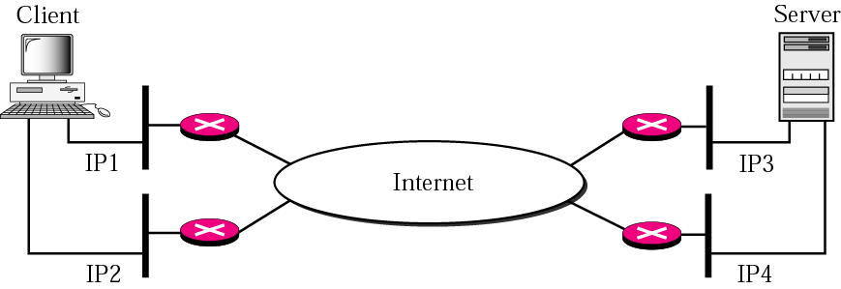
Figure 13.3 Multihoming concept
Notes:
一个关联两端的主机可以有多个IP，一条路径级故障，不影响别的路径，故障容许能力大为提高，实际实现中，一对IP正常通信，其余候选

Slide 9
Note:
SCTP association allows multiple IP addresses for each end.
SCTP关联允许每一端使用多个IP地址

Slide 10
全双工通信
面向连接的服务
面向连接强调建立关联（/协商），数据传送，关联终止。
无连接。
可靠的服务
确认机制，可靠也是面向连接的一个特点。
Notes:
全双工通信，双向流动； 无确认指的是这个协议层面，无确认。ICMP是辅助确认。

Slide 11
13.2 SCTP FEATURES
We discuss the general features of SCTP and then compare them with those of TCP.
The topics discussed in this section include:
Transmission Sequence Number (TSN)
Stream Identifier (SI)
Stream Sequence Number (SSN)
Packets
Acknowledgment Number
Flow Control
Error Control
Congestion Control

Slide 12
Note:
In SCTP, a data chunk is numbered using a TSN.传输序号
不考虑传输层分片，从进程来的报文跟SCTP分组的数据块可以是一一对应的。
Notes:
TCP是字节为单位，SCTP是数据块为单位，同样SCTP有分片机制，与来自用户进程的报文可以一一对应，可以不一一对应，TSN 数据宽度为32bits

Slide 13
Note:
To distinguish between different streams, SCTP uses a SI.流标识符
Notes:
SCTP的一个关联可能有多个流，还需要Stream identifier， 每个数据块必须在其首部中携带这个SI，SI为16bit的

Slide 14
Note:
To distinguish between different data chunks belonging to the same stream, SCTP uses SSNs.流序号
Notes:
两重标识，每个流中的每个数据库还定义了一个流序号SSN

Slide 15
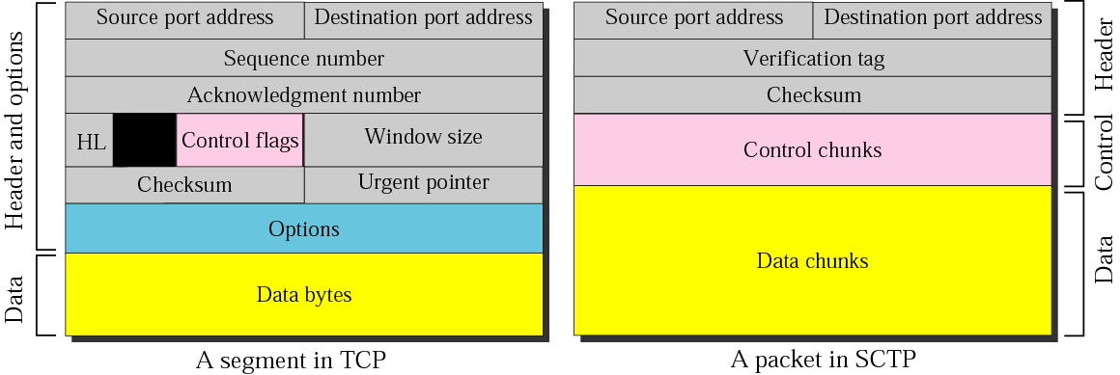
Figure 13.4 Comparison between a TCP segment and an SCTP packet
TCP中，首部含有控制信息；
SCTP中数据由数据块携带，控制信息由控制块携带；

Slide 16
Note:
TCP has segments; 报文段
SCTP has packets.
分组

Slide 17
Note:
In SCTP, control information and data information are carried in separate chunks.

Slide 18
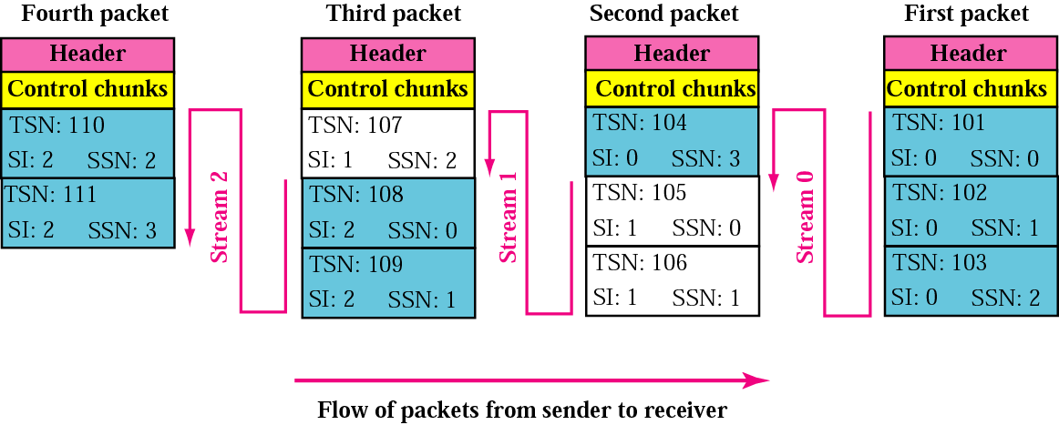
Figure 13.5 Packet, data chunks, and streams

Slide 19
Note:
Data chunks are identified by three identifiers: TSN, SI, and SSN.
TSN is a cumulative number identifying the association; SI defines the stream; SSN defines the chunk in a stream.

Slide 20
Note:
In SCTP, acknowledgment numbers are used to acknowledge only data chunks; control chunks are acknowledged by other control chunks if necessary.

Slide 21
13.3 PACKET FORMAT
We show the format of a packet and different types of chunks. An SCTP packet has a mandatory general header and a set of blocks called chunks. There are two types of chunks: control chunks and data chunks.
The topics discussed in this section include:
General Header
Chunks

Slide 22
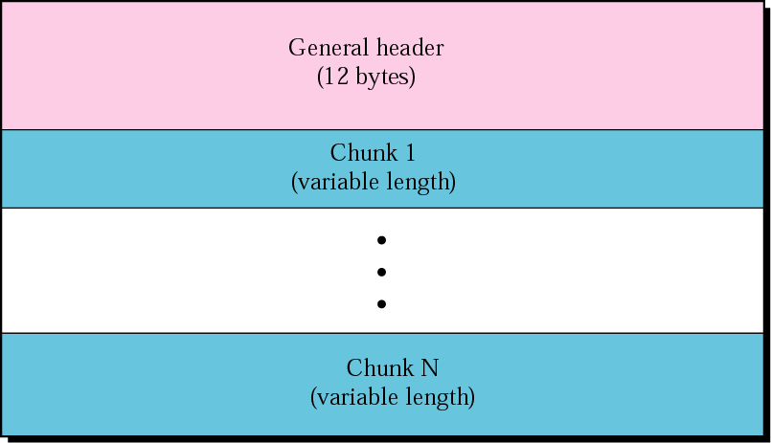
Figure 13.6 SCTP packet format

Slide 23
Note:
In an SCTP packet, control chunks come before data chunks.

Slide 24
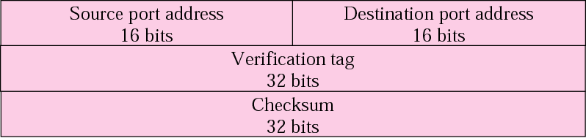
Figure 13.7 General header

Slide 25
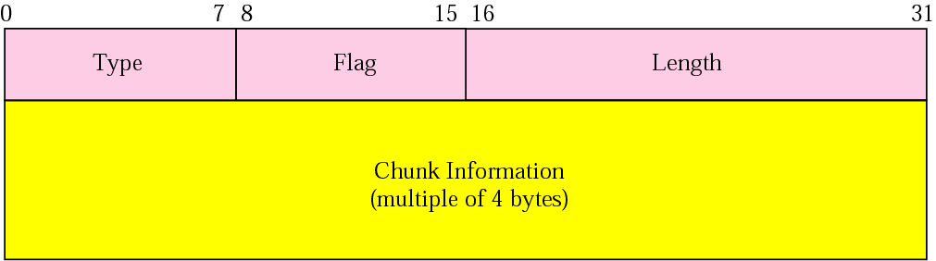
Figure 13.8 Common layout of a chunk

Slide 26
Note:
Chunks need to terminate on a 32-bit (4 byte) boundary.

Slide 27
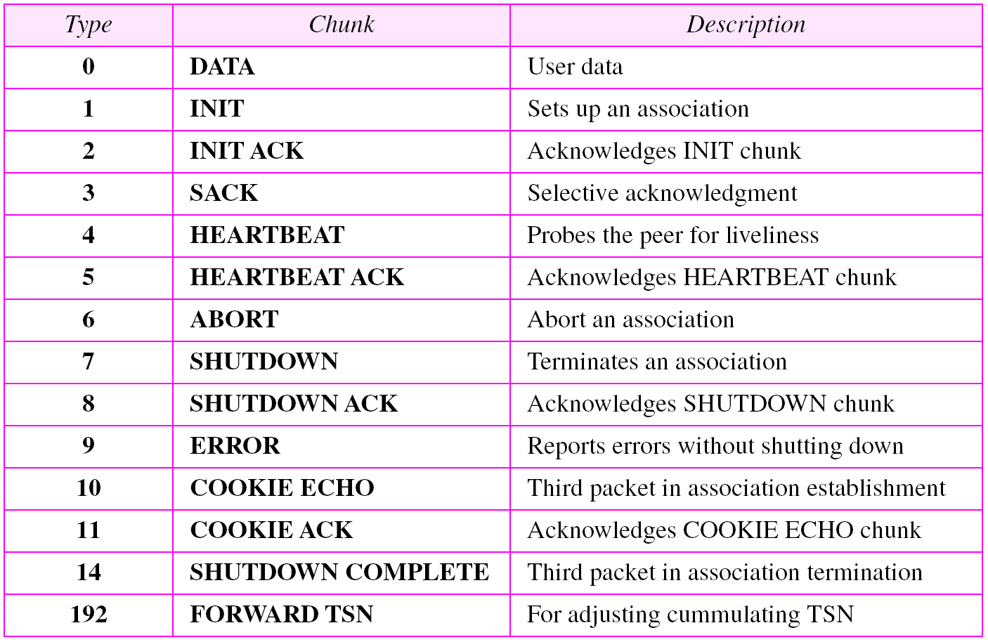
Table 13.2 Chunks

Slide 28
Note:
The number of padding bytes are not included in the value of the length field.
长度字段值不包含填充的字节数

Slide 29
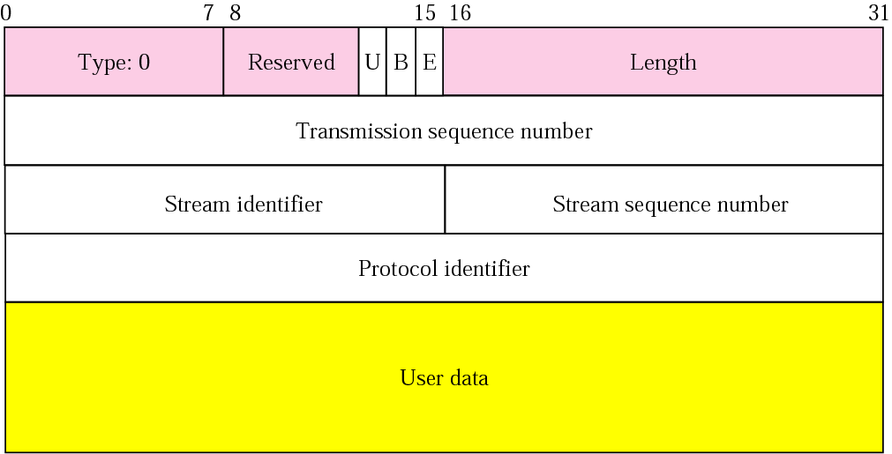
Figure 13.9 DATA chunk

Slide 30
Note:
A DATA chunk cannot carry data belonging to more than one message, but a message can be split into several chunks. The data field of the DATA chunk must carry at least one byte of data, which means the value of length field cannot be less than 17.

Slide 31
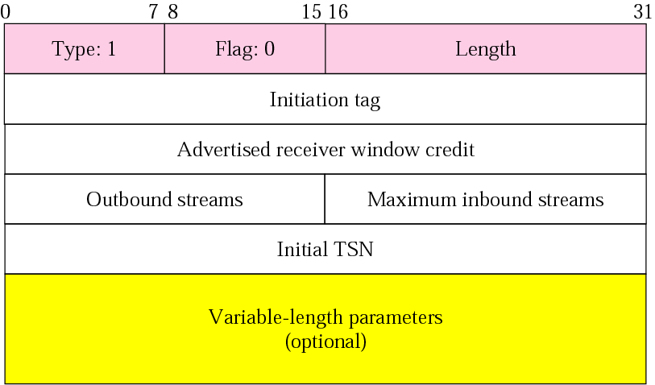
Figure 13.10 INIT chunk

Slide 32
Note:
No other chunk can be carried in a packet that carries an INIT chunk.

Slide 33
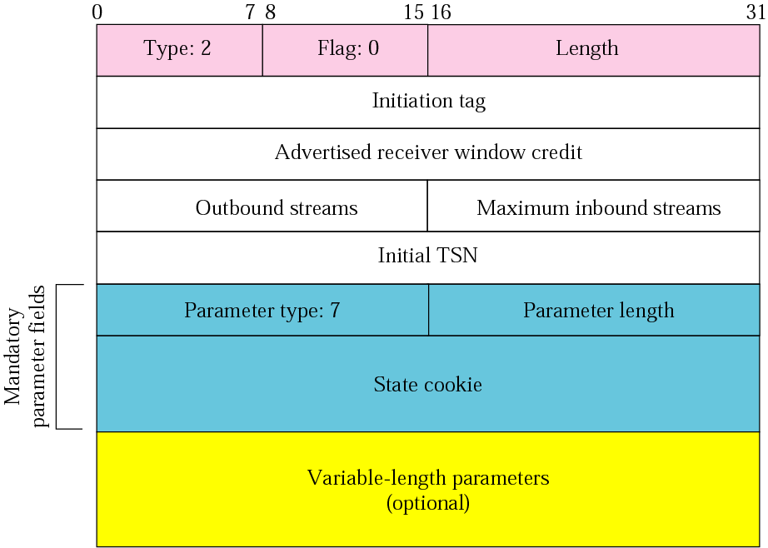
Figure 13.11 INIT ACK chunk

Slide 34
Note:
No other chunk can be carried in a packet that carries an INIT ACK chunk.

Slide 35
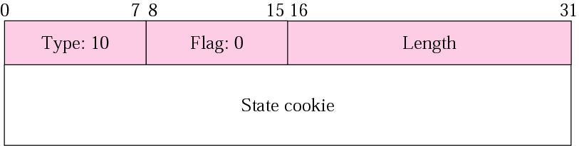
Figure 13.12 COOKIE ECHO chunk

Slide 36

Figure 13.13 COOKIE ACK

Slide 37
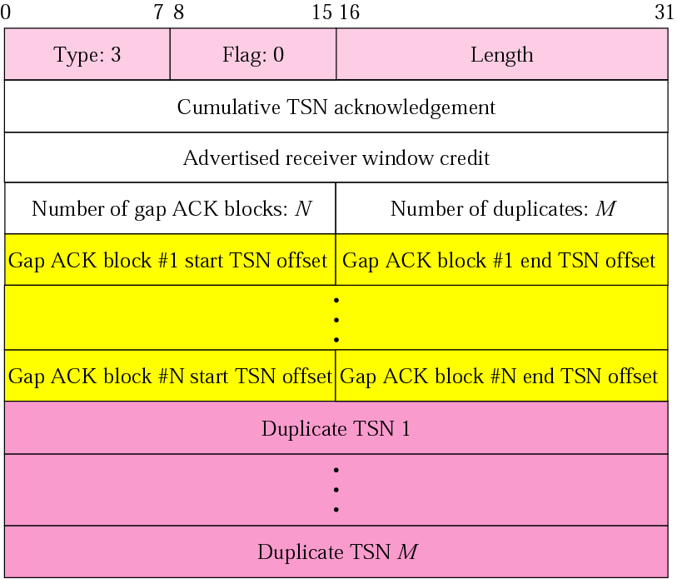
Figure 13.14 SACK chunk

Slide 38
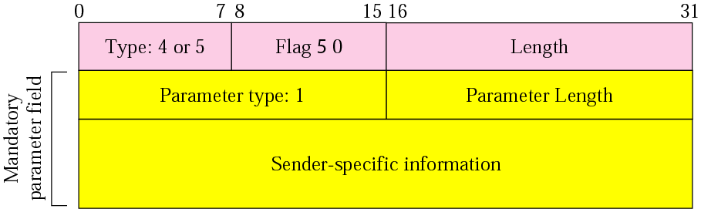
Figure 13.15 HEARTBEAT and HEARTBEAT ACK chunks

Slide 39
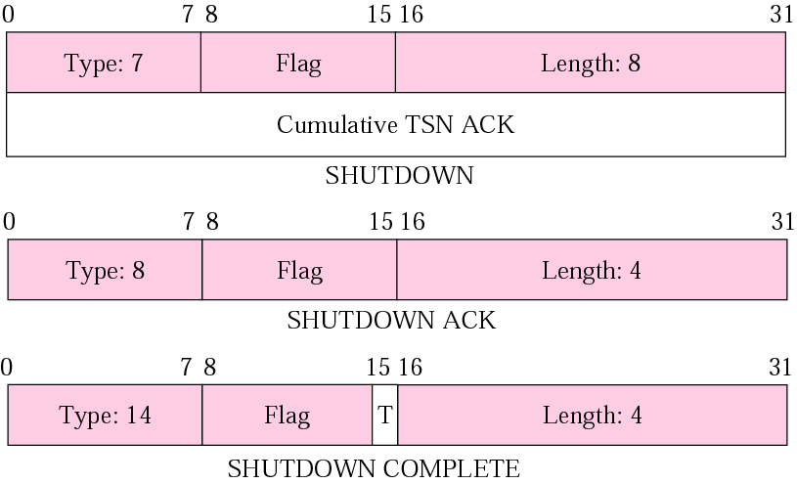
Figure 13.16 SHUTDOWN, SHUTDOWN ACK, and SHUTDOWN COMPLETE chunks

Slide 40
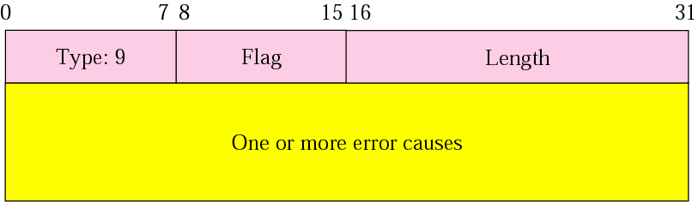
Figure 13.17 ERROR chunk

Slide 41
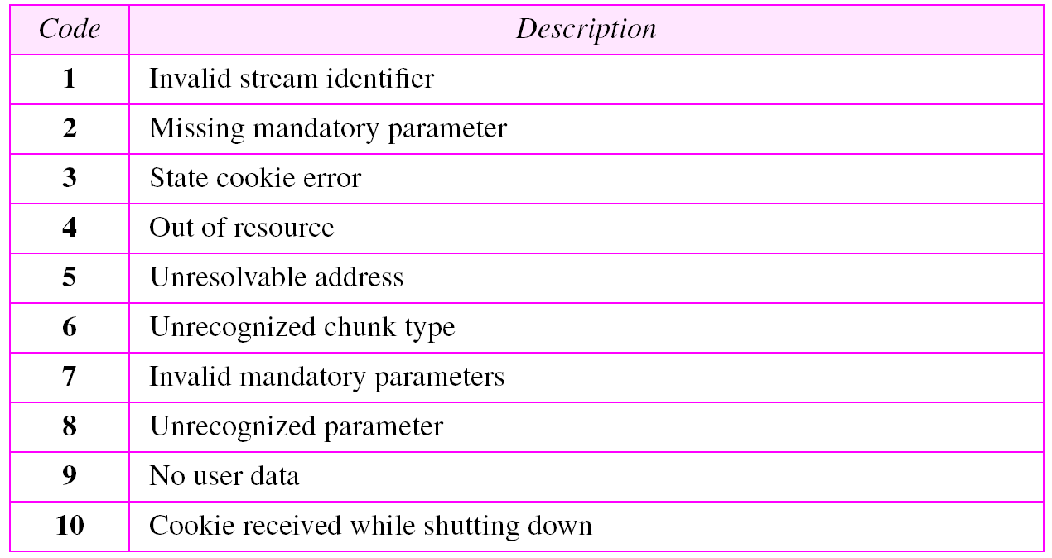
Table 13.3 Errors

Slide 42
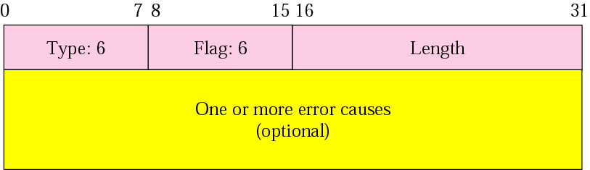
Figure 13.18 ABORT chunk

Slide 43
13.4 AN SCTP ASSOCIATION
SCTP, like TCP, is a connection-oriented protocol. However, a connection in SCTP is called an association to emphasize multihoming
The topics discussed in this section include:
Association Establishment
Data Transfer
Association Termination
Association Abortion

Slide 44
Note:
A connection in SCTP is called an association.

Slide 45
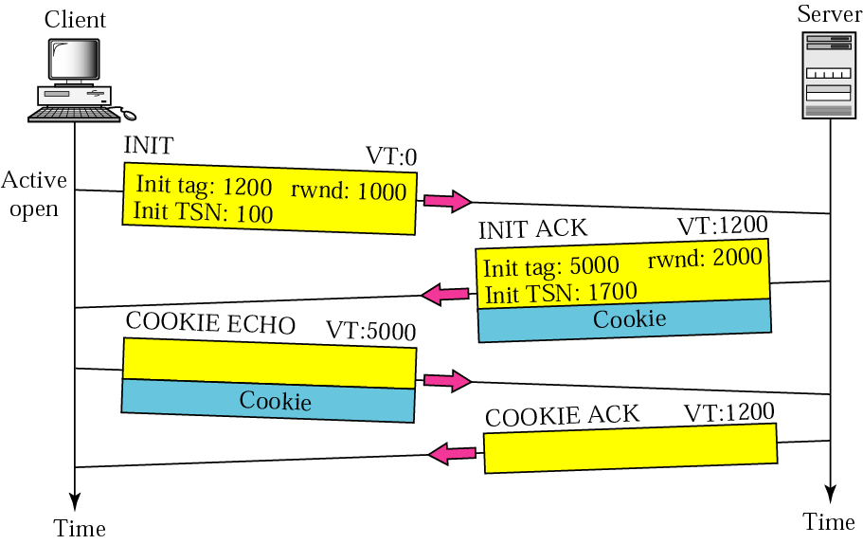
Figure 13.19 Four-way handshaking

Slide 46
Cookie
Cookie是当你访问某个站点时，随某个HTML网页发送到你的浏览器中的一小段信息.
SCTP防止TCP中出现的泛洪攻击，DOS攻击。

Slide 47
SCTP建立关联交换的分组数
尽管是4次握手，但是在第三个，第四个分组就可以传送数据了。同时在防止SYN拒绝服务的攻击方面提供了更高的安全性。

Slide 48
验证标志
（TCP）问题1.一个盲目的攻击者可以像我们在SYN攻击中一样，使用随机选出的源端口地址和目的端口地址像一个TCP服务器发送报文段。
（TCP）问题2.从前面的连接传过来的延迟的报文段可能在一个新的连接中出现，此报文段使用了同样的源端口地址和目的端口地址。这也是TCP在终止连接时需要有Time-wait计时器的一个原因。

Slide 49
Note:
No other chunk is allowed in a packet carrying an INIT or INIT ACK chunk.
A COOKIE ECHO or a COOKIE ACK chunk can carry DATA chunks.

Slide 50
Note:
In SCTP, only DATA chunks consume TSNs;
DATA chunks are the only chunks that are acknowledged.

Slide 51
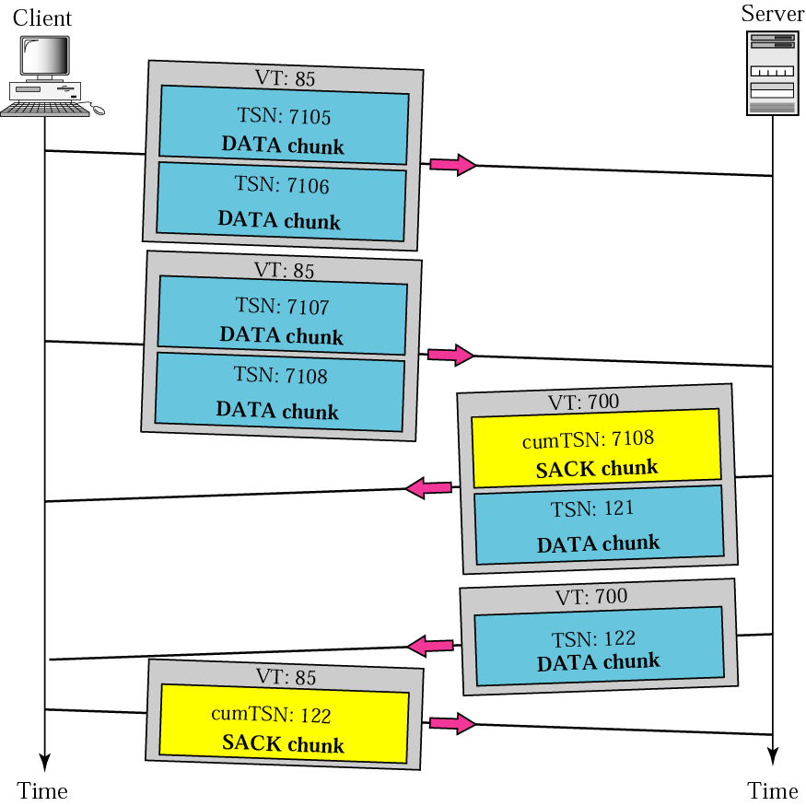
Figure 13.20 Simple data transfer

Slide 52
Note:
The acknowledgment in SCTP defines the cumulative TSN, the TSN of the last DATA chunk received in order.

Slide 53
多归属数据传送
一个端点关联多个IP地址。

Slide 54
Multi-homed Considerations
Endpoint-1
Endpoint-2
NI-1
NI-2
NI-1
NI-2
IP Network
IP Network
When a peer is multi-homed, a “primary destination address” is selected by the SCTP endpoint.
By default, all data is sent to this primary address.
When the primary address fails, the sender selects an alternate primary address until it is restored or the user changes the primary address.

Slide 55
Unreachable Destination Address
Endpoint-1
Endpoint-2
NI-1
NI-2
NI-1
NI-2
X
IP Network
IP Network

Slide 56
Unreachable Peer: Network Failure
Endpoint-1
Endpoint-2
NI-1
NI-2
NI-1
NI-2
X
IP Network
X
IP Network

Slide 57
Maximum Path Diversity
Endpoint-1
Endpoint-2

Slide 58
Minimum Path Diversity
Endpoint-1
Endpoint-2

Slide 59
Now a VERY brief example: daytime client/server (full socket API discussion comes later)
Network applications are typically client/server
daytime server
open a socket and bind it to a port
listen for connections
while (1)
{
accept a connection
send a string containing current date/time
close the connection
}
daytime client
create a socket
open a connection to daytime server
read bytes until EOF (meaning connection was closed)
close connection

Slide 60
A TCP daytime client becomes an SCTP daytime client...
TCP daytime client (many details omitted, including error checking;）
int sockfd, n;
char recvline[MAXLINE + 1]; /* read buffer*/
struct sockaddr_in servaddr;
sockfd = socket(AF_INET, SOCK_STREAM, 0); /* create TCP socket */
/* fill in socket address structure */
servaddr.sin_family = AF_INET; servaddr.sin_port = htons(13);
inet_pton(AF_INET, argv[1], &servaddr.sin_addr); /*dot dec to n.b.o.*/
connect(sockfd, (struct sockaddr *) &servaddr, sizeof(servaddr));
while ( (n = read(sockfd, recvline, MAXLINE)) > 0 )
{
recvline[n]=0; /* null terminate */
fputs(recvline, stdout);
}
close (sockfd);
Note: 0 implies IP_PROTO_TCP
sockfd = socket(AF_INET, SOCK_STREAM, IP_PROTO_SCTP); /* SCTP socket */

Slide 61
多重流交付
SI唯一地定义一个流
紧急数据可以不按序交付
Notes:
P313

Slide 62
分片
SCTP在从一个报文产生DATA块时，如果报文长度不超过路径的MTU，那么进程到进程都会保留报文的边界。如果总长度超过MTU，SCTP报文进行分片。
1.报文划分为更小的分片，以满足长度的需求；
2.每一个分片必须加上具有不同TSN的DATA块的首部。TSN必须按序。
3.所有的首部携带同样的流标识符SI，同样的流序号SSN，同样的有效载荷协议标识符，以及同样的U标志。
4.B和E的指派。

Slide 63
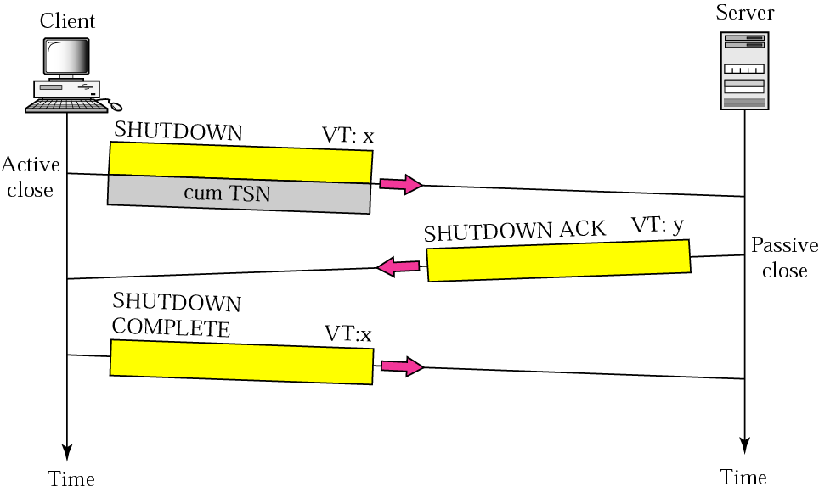
Figure 13.21 Association termination 关联终止

Slide 64
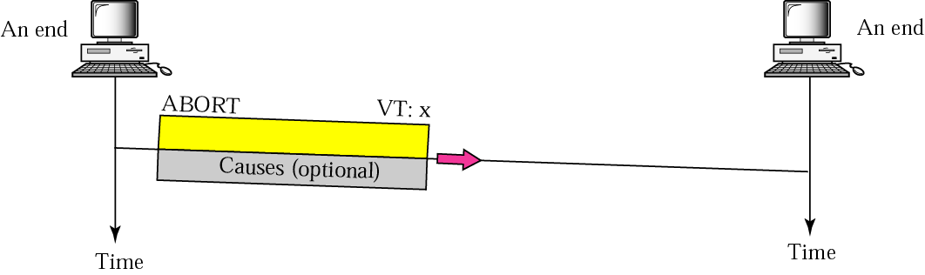
Figure 13.22 Association abortion
如果一个进程觉得本身有些问题（进入无限循环，从另一端收到错误的数据，等），可以使用关联异常终止。

Slide 65
13.5 STATE TRANSITION DIAGRAM
To keep track of all the different events happening during association establishment, association termination, and data transfer, the SCTP software, like TCP, is implemented as a finite state machine.
为了掌握在关联建立、关联终止和数据传送时所发生的不同事件，像TCP一样，SCTP软件也是以有限状态机的方式来实现的。
The topics discussed in this section include:
Scenarios
Simultaneous Close

Slide 66
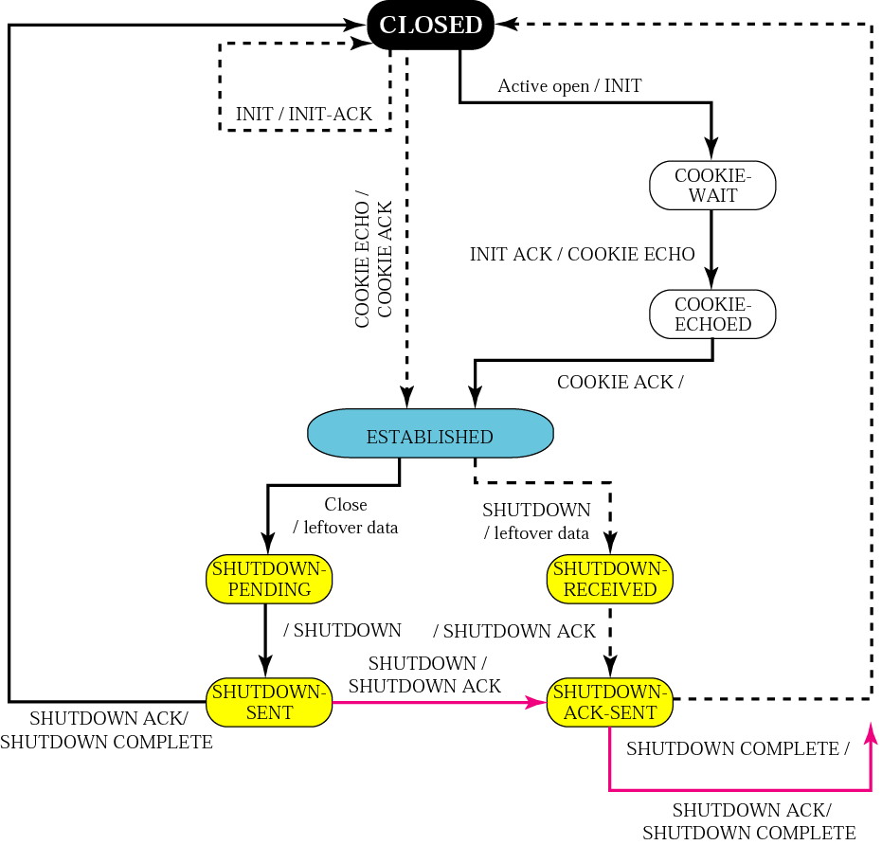
Figure 13.23 State transition diagram

Slide 67
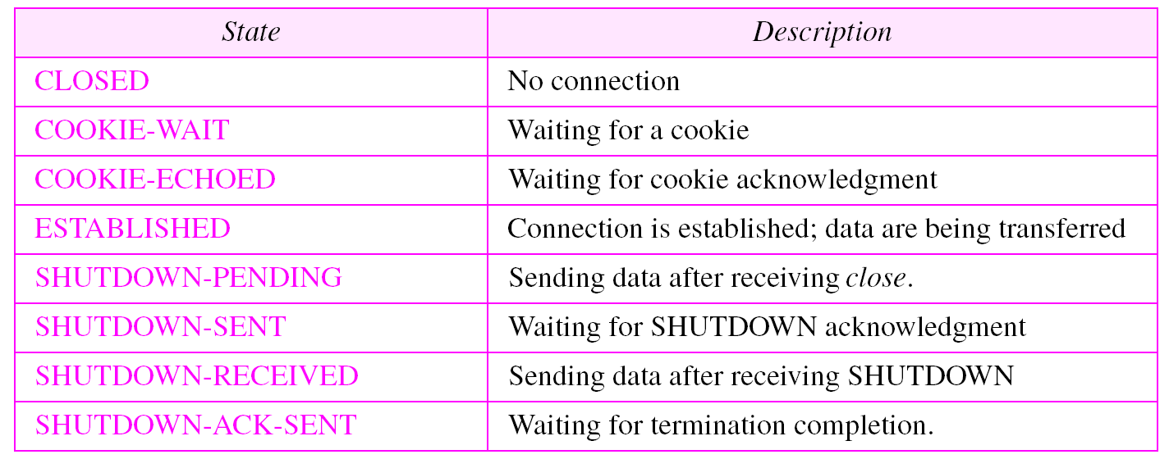
Table 13.4 States for SCTP

Slide 68
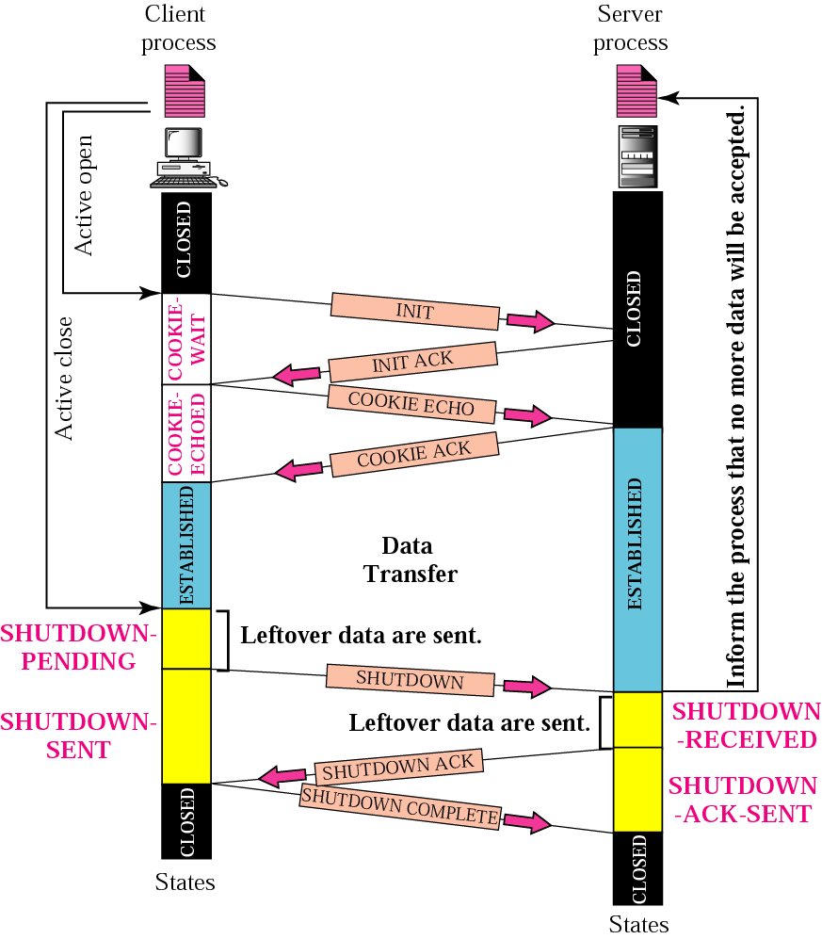
Figure 13.24 A common scenario of states

Slide 69
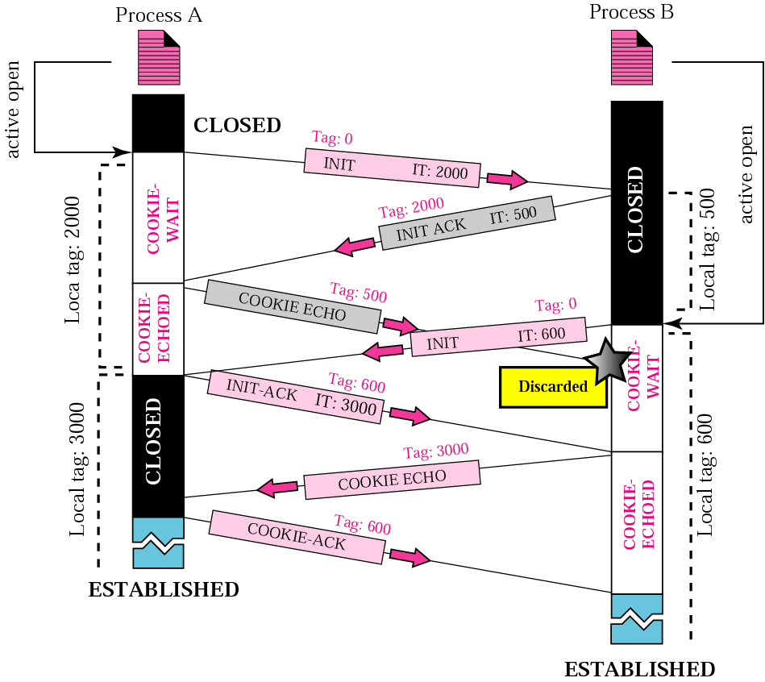
Figure 13.25 Simultaneous open

Slide 70
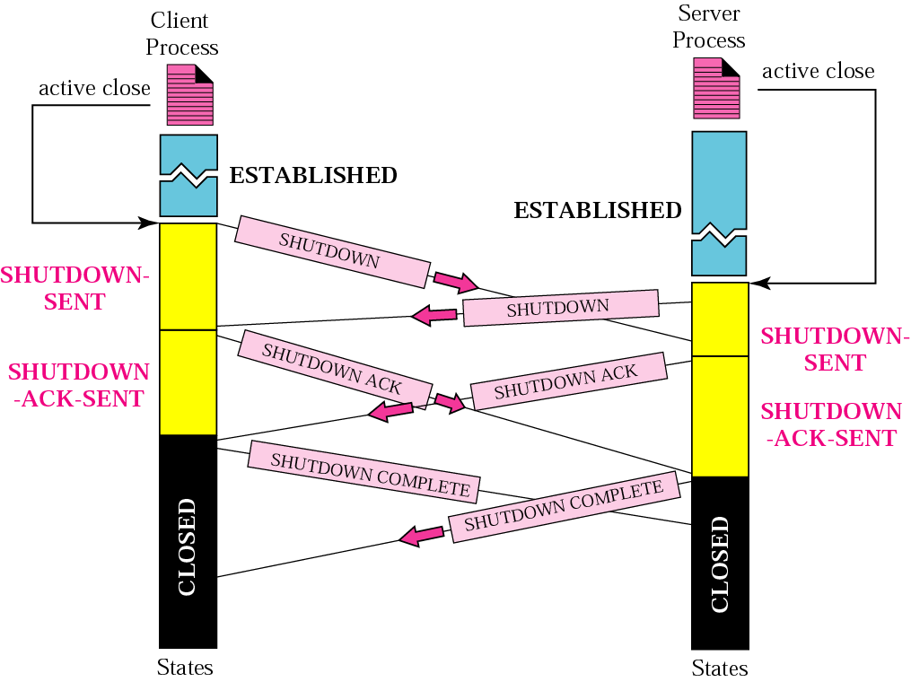
Figure 13.26 Simultaneous close

Slide 71
13.6 FLOW CONTROL
Flow control in SCTP is similar to that in TCP. In SCTP, we need to handle two units of data, the byte and the chunk.
Rwnd,cwnd的值用byte来表示
TSN（传输序号）和确认用块来表示
The topics discussed in this section include:
Receiver Site
Sender Site
A Scenario

Slide 72
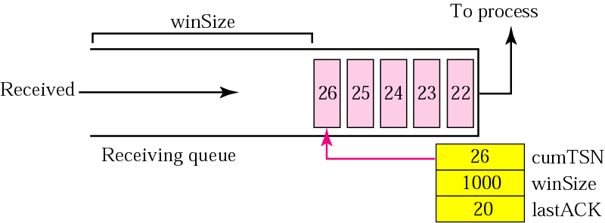
Figure 13.27 Flow control, receiver site

Slide 73
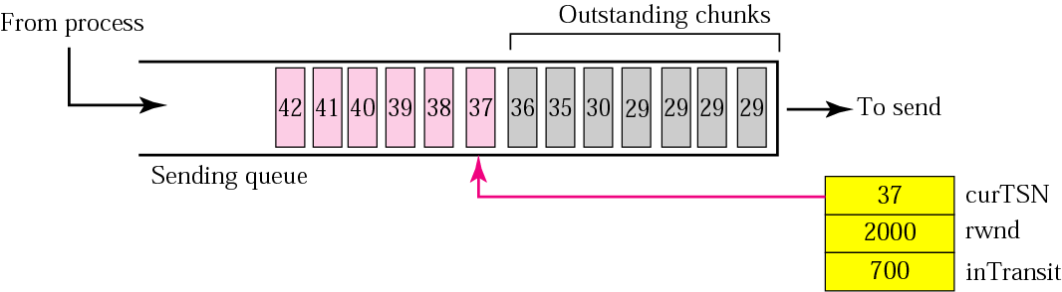
Figure 13.28 Flow control, sender site

Slide 74
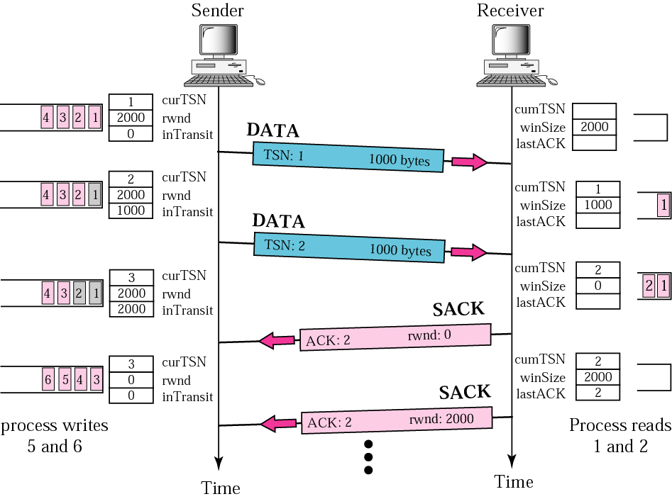
Figure 13.29 Flow control scenario

Slide 75
13.7 ERROR CONTROL
SCTP uses a SACK chunk to report the state of the receiver buffer to the sender. Each implementation uses a different set of entities and timers for the receiver and sender sites.
SCTP使用SACK块向发送端报告接收端缓存的状态。每一种实现在接收端和发送端使用不同的实体和定时器的集合。
The topics discussed in this section include:
Receiver Site 接收端
Sender Site 发送端
Sending Data Chunks发送数据块
Generating SACK Chunks 生成SACK块

Slide 76
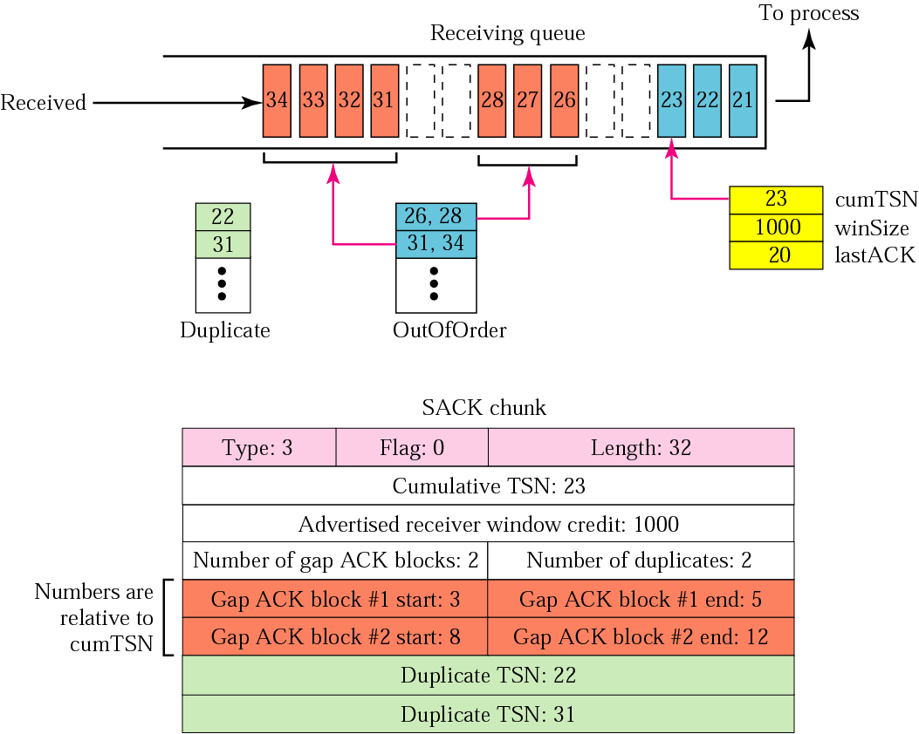
Figure 13.30 Error control, receiver site

Slide 77
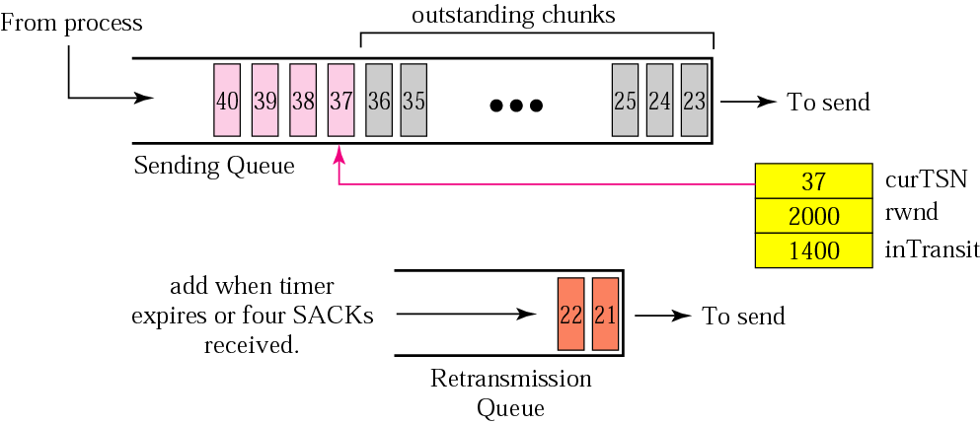
Figure 13.31 Error control, sender site

Slide 78
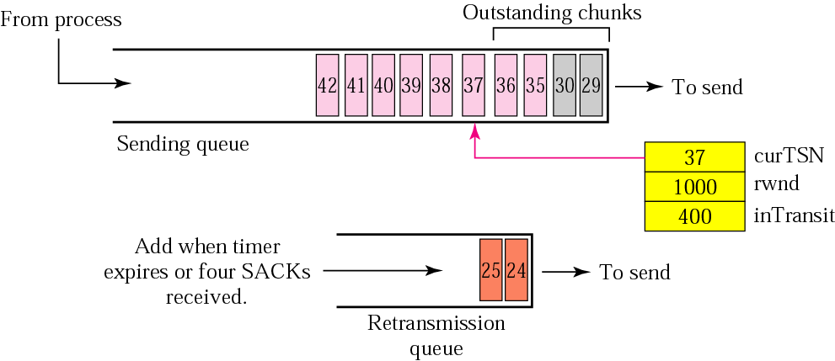
Figure 13.32 New state at the sender site after receiving a SACK chunk

Slide 79
发送数据块
重传策略
对于每个分组使用重传定时器
收到对同样的丢失块的4个SACK

Slide 80
生成SACK块
1.当一端向另一端发送DATA块时，它必须包含一个SACK块，用来通知收到的未被确认的DATA块；
2.当一端收到包含数据的分组时，如果它没有数据要发送，它就必须在指明的时刻内（通常是500ms）确认收到了这个分组；
3.一端收到失序数据块分组时，立即发送SACK；
4.一端收到重复数据块分组时，立即发送SACK。

Slide 81
13.8 CONGESTION CONTROL
SCTP uses the same strategies for congestion control as TCP. SCTP uses slow start, congestion avoidance, and congestion detection phases. SCTP also uses fast retransmission and fast recovery.
指数增大
加法增大
乘法减小
The topics discussed in this section include:
Congestion Control and Multihoming
Explicit Congestion Notification

Slide 82
拥塞控制与多归属
端点需要为每一个IP地址设置不同的cwnd值

Slide 83
显式拥塞通知
如果接收端遇到了很多延迟的或者重复的分组，这就是一种可能发生网络拥塞的指示。SCTP可以在INIT和INITACK中使用一个ECN选项，使双方能够协商ECN的使用。

Slide 84
SCTP协议的应用
软交换网络

Slide 85
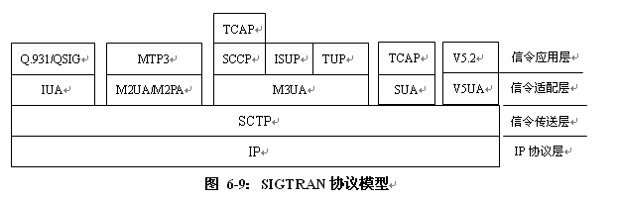
SIGTRAN协议体系
原则上SIGTRAN封装在IP中进行传送，协议体系主要由两个部件组成，即信令适配层、信令传送层，底层采用的是标准的IP协议。
信令适配层提供SCN信令的标准原语接口，而信令传送层则提供SCN信令要求的实时和可靠传送。
Notes:
IUA（ISDN Q.921-User Adaptation Layer）：ISDN Q.921用户适配层协议。
M2UA（MTP2-User Adaptation Layer）：MTP第二级用户的适配层协议，该协议允许信令网关向对等的IP SP传送MTP3消息，对SS7信令网和IP网提供无缝的网管互通功能。
M2PA（MTP2-User Peer to Peer Adaptation Layer）：MTP第二级用户的对等适配层协议，该协议允许信令网关向IP SP处理及传送MTP3的消息，并提供MTP信令网网管功能。
M3UA（MTP3-User Adaptation Layer）：MTP第三级用户的适配层协议，该协议允许信令网关向媒体网关控制器或IP数据库传送MTP3的用户信息（如ISUP/SCCP消息），对SS7信令网和IP网提供无缝的网管互通功能。
SUA（SCCP-User Adaptation Layer）：SCCP用户的适配层协议，它的主要功能是适配传送SCCP的用户信息给IP数据库，提供SCCP的网管互通功能。
V5UA（V5.2- User Adaptation Layer）：V5.2用户的适配层协议，完成V5.2信令数据在媒体网关和软交换/MGC之间的传送。
SCTP（Stream Control Transmission Protocol）：流控制传输协议，是一个面向连接的传输层协议，它在对等的SCTP用户之间提供可靠的面向用户消息的传输服务。相对于TCP等其它传输协议来说，它传输时延小，可避免某些大数据对其它数据的阻塞，有更高的传输效率和可靠性，有更高的重发效率，具有更好的安全性。

Slide 86
软交换与PSTN交换机的区别
将传统交换机的功能模块分离成为独立的网络部件，各个部件可以按相应的功能划分各自独立发展。
部件间的协议接口基于相应的标准。
部件化使得原有的电信网络逐步走向开放，运营商可以根据业务的需要自由组合各部分的功能产品采组建网络；部件间协议接口的标准化可以实现各种异构网的互通。

Slide 87
Thanks

